Slide 1
Network and information system
Final Project Graduation
Realized by : BOU SABA Elie
Under the direction of :
M. SINARDET Bernard
IT manager

Slide 2
Plan
Introduction and presentation of St. Dominique
01
Vision and mission
Data sheet
Observations made and tasks performed
02
Personal reflection and analysis
Observations made
Completed tasks (VLAN, DHCP, VPN)
03
Project evaluation
Experiences acquired
Difficulties and solutions
04
Conclusion
1

Slide 3
Introduction
01
2

Slide 4

Private establishment : - Kindergarten - Primary school - Students hostel
Vision and mission
3

Slide 5
Company Data sheet
Company Name: | OGEC ST-DOMINIQUE
Creation Date: | 1900
Address : | 21000 Dijon
Activity area | Primary education
Number of employees: | 50
4
Notes:
Donner des exemples :
-> SAAS : Google G Suite, Microsoft Office 365, Dropbox
-> PAAS : Google App Engine et AWS Elastic Beanstalk
-> IAAS : Amazon Web Services, Microsoft Azure et Google Compute Engine
IAAS : Mise a la disposition d'une infrastructure matérielle virtuelle (les serveurs virtuels, les réseaux (routeurs et commutateurs), les espaces de stockage, les machines virtuelles et les systèmes d’exploitation) localisée physiquement à distance dans des Datacenters chez le prestataire du service.
PAAS : Assure un environnement d'exécution en ligne qui fournit spécialement aux développeurs des plateformes (bases de données, serveurs d'application comme Apache Tomcat) sur lesquelles ils peuvent développer, tester, déployer et héberger leurs applications web via l’Internet.
SAAS : Permet aux entreprises d’accéder par le biais d’une interface via l’internet aux différentes applications allant du CRM à la gestion des ressources humaines, comptabilité, messagerie et d’autres applications métiers selon leurs besoins.

Slide 6
02
Observations made and tasks performed
5

Slide 7

Personal reflection and analysis
Deep understanding of the system
Closer look at the architecture
Perform analyzes based on learned theory
6
Notes:
Donner des exemples :
-> SAAS : Google G Suite, Microsoft Office 365, Dropbox
-> PAAS : Google App Engine et AWS Elastic Beanstalk
-> IAAS : Amazon Web Services, Microsoft Azure et Google Compute Engine
IAAS : Mise a la disposition d'une infrastructure matérielle virtuelle (les serveurs virtuels, les réseaux (routeurs et commutateurs), les espaces de stockage, les machines virtuelles et les systèmes d’exploitation) localisée physiquement à distance dans des Datacenters chez le prestataire du service.
PAAS : Assure un environnement d'exécution en ligne qui fournit spécialement aux développeurs des plateformes (bases de données, serveurs d'application comme Apache Tomcat) sur lesquelles ils peuvent développer, tester, déployer et héberger leurs applications web via l’Internet.
SAAS : Permet aux entreprises d’accéder par le biais d’une interface via l’internet aux différentes applications allant du CRM à la gestion des ressources humaines, comptabilité, messagerie et d’autres applications métiers selon leurs besoins.

Slide 8
Main entities in the establishment
● 2 routers to manage school and students hostel networks
● 4 manageable switches (including 2 switches dedicated to video surveillance and supplying POE cameras)
● 5 unmanaged switches distributed on the floors of the main building and 2 others in the pavilion
● 1 Windows Server 2019 for administration : Management of day-to-day updates, synchronization of tools, etc…
● 1 file server: teachers accounts, shared documents, etc... (Ubuntu Linux)
● 2 NAS, network backup disks (Linux with RAID disks)
● 10 PCs for administration, 16 PCs for classes and 10 Access points to supply the school and the students hostel.
7
Notes:
Donner des exemples :
-> SAAS : Google G Suite, Microsoft Office 365, Dropbox
-> PAAS : Google App Engine et AWS Elastic Beanstalk
-> IAAS : Amazon Web Services, Microsoft Azure et Google Compute Engine
IAAS : Mise a la disposition d'une infrastructure matérielle virtuelle (les serveurs virtuels, les réseaux (routeurs et commutateurs), les espaces de stockage, les machines virtuelles et les systèmes d’exploitation) localisée physiquement à distance dans des Datacenters chez le prestataire du service.
PAAS : Assure un environnement d'exécution en ligne qui fournit spécialement aux développeurs des plateformes (bases de données, serveurs d'application comme Apache Tomcat) sur lesquelles ils peuvent développer, tester, déployer et héberger leurs applications web via l’Internet.
SAAS : Permet aux entreprises d’accéder par le biais d’une interface via l’internet aux différentes applications allant du CRM à la gestion des ressources humaines, comptabilité, messagerie et d’autres applications métiers selon leurs besoins.

Slide 9
VLANs Description
Definition of a LAN
A local area network (LAN) is a collection of devices connected together in one physical location.
Definition of a VLAN
- A virtual local area network (VLAN) is a subnetwork that group together multiple devices to create a separate LAN.
- Without the addition of VLANs, all the interfaces of a switch are considered on the same network (same LAN) and therefore on the same broadcast domain.

Slide 10
Advantages of using VLANs
1- Performance : By minimizing the broadcast domain, the flooding of a packet is limited to switch
ports that belong to a VLAN.
2- Security: By separating traffic flows, not all users will have access to all traffic.
3- QoS: By having a separate stream for VoIP for example, we offer some sort of quality of service.

Slide 11
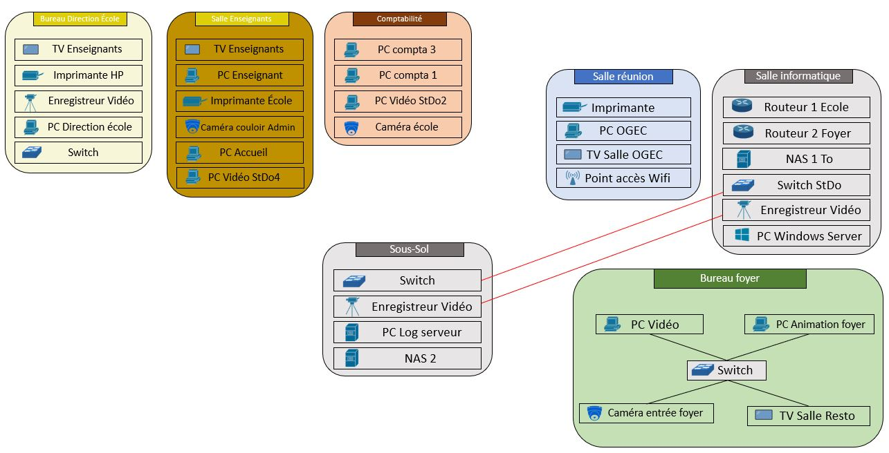
Topology without VLANs
2 main networks :
● School network :
192.168.0.0/24
● Students hostel network :
192.168.1.0/24
10

Slide 12
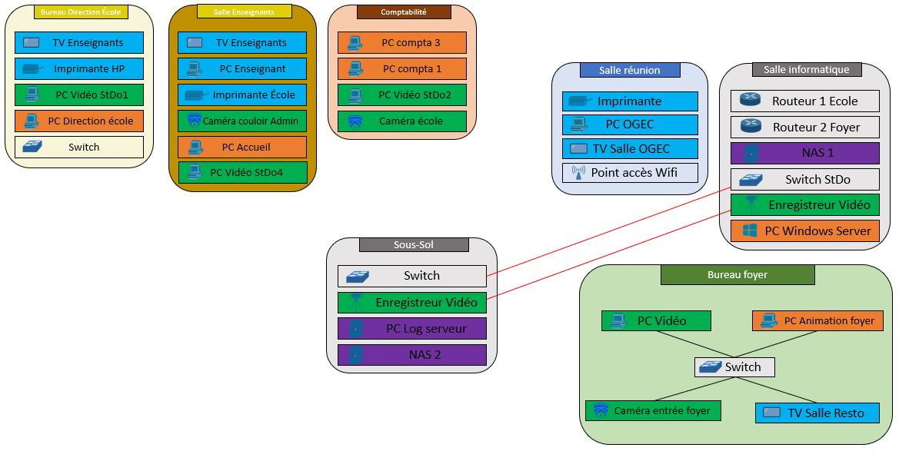
Implementation of VLANs
VLAN 20 (Management)
192.168.20.0/24
VLAN 30 (Administration)
192.168.30.0/24
VLAN 40 (Video) 192.168.40.0/24
VLAN 50 (School)
192.168.50.0/24
11

Slide 13
Installing DHCP on Windows Server 2019
/1
Definition of a DHCP server
Dynamic Host Configuration Protocol (DHCP) is a network management protocol used to automate the process of configuring devices on IP networks.
Advantages of using DHCP
Reliable configuration : Reduce human configuration errors.
1
Centralized configuration of network clients: Configuration data is stored in the same place.
2
Minimal network administration.
3
12

Slide 14
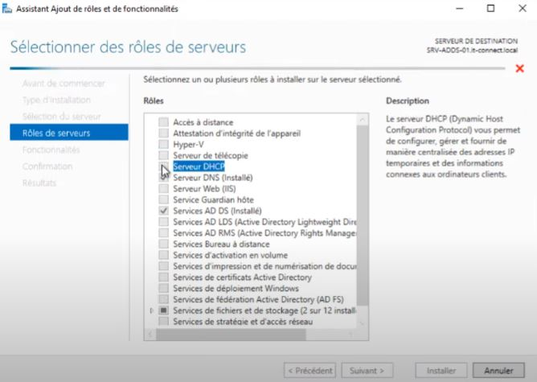
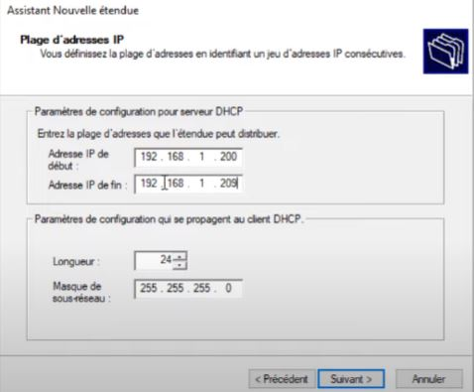
Installing DHCP on Windows Server 2019
/2
Add role DHCP
Configure IP range
13

Slide 15
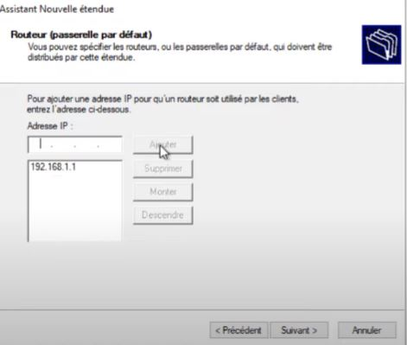
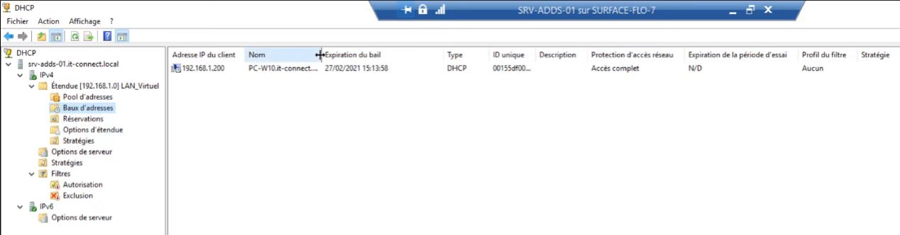
Installing DHCP on Windows Server 2019
/2
Add default gateway
Check DHCP clients
14

Slide 16
Remote Access VPN on Windows Server 2019
/1
What is a VPN?
A VPN (Virtual Private Network) is the fact of having 2 or more machines that are on a private network where the entities concerned communicate with each other securely on a public network.
2 types of VPN
- Site to Site : A connection between two or more networks, such as a corporate network and a branch office network.
Remote Access : A connection between an individual machine and a private network that requires the installation of software on the customer's machine that establishes a secure, well-encrypted tunnel.
15

Slide 17
Advantages of using a VPN
1- Remote Access to Information Anytime : Regardless of location, VPNs can be used by employees anytime and anywhere, as long as there’s internet and an approved device being used.
2- Data Security : Using a VPN keeps employees, and valuable client data off public networks
1- Performance : By minimizing the broadcast domain, the flooding of a packet is limited to switch
ports that belong to a VLAN.
2- Security: By separating traffic flows, not all users will have access to all traffic.
3- QoS: By having a separate stream for VoIP for example, we offer some sort of quality of service.

Slide 18
Remote Access VPN on Windows Server 2019
/2
Some Steps to Follow for Implementing Remote Access VPN Service on Windows Server 2019
A) Installing the Remote Access role on Windows Server.
B) Configuring Remote Access for VPN service only.
C) User Access Configuration.
D) Configuring port forwarding on the router.
E) Configuration of the VPN on the client's machine.
F) Test the connection

Slide 19
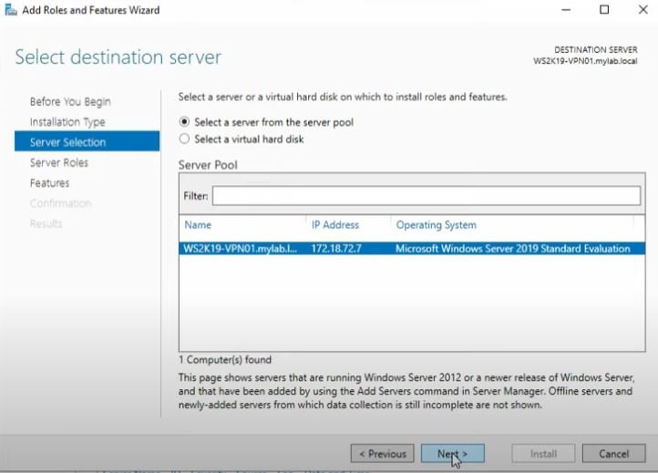
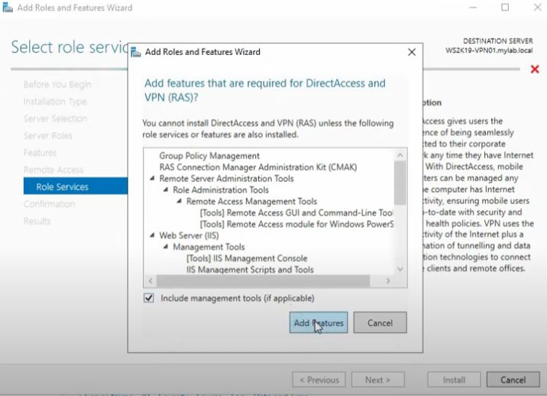
Remote Access VPN on Windows Server 2019
/2
Add remote access Role on server
Installing the DirectAccess and VPN service
18

Slide 20
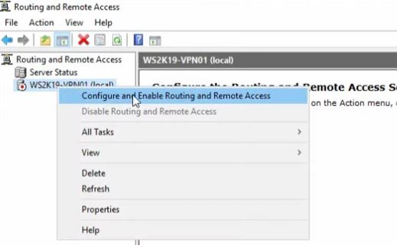
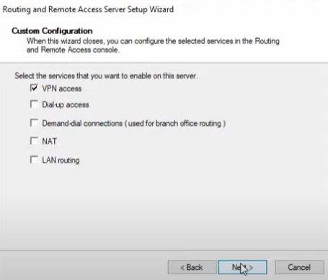
Remote Access VPN on Windows Server 2019
/2
Configuration of Remote Access and routing on the server
Add VPN access
19

Slide 21
Remote Access VPN on Windows Server 2019
/2
Configure the Active Directory of the Windows Server to give the clients VPN access to the private network of the establishment.
Activate port forwarding on the router to allow connection from outside and choose 'L2TP' in the port service field in the router's port forwarding settings.
20

Slide 22
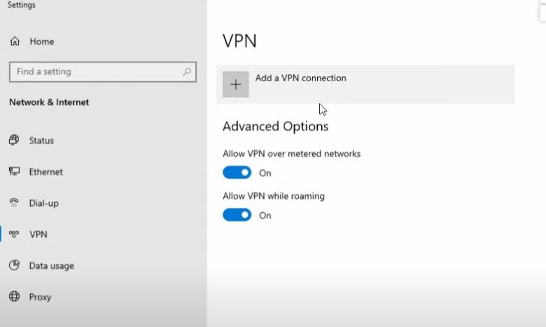
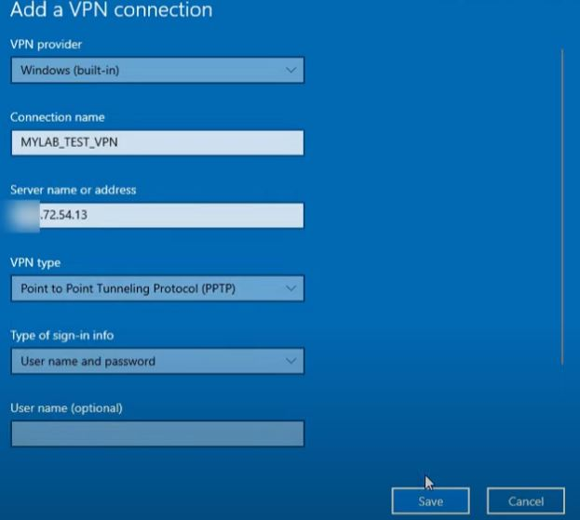
Remote Access VPN on Windows Server 2019
/2
Configuration of the VPN on the client machine

Slide 23
03
Project evaluation
22

Slide 24
Experiences acquired
Disponibilité
Learned new concepts and deepened my knowledge in systems and networks.
Acquired social and communication skills in a professional environment.
Taux de perte de paquets
Gigue
NaaS - IaaS
Temps de réponse
Latence
NaaS
NaaS
NaaS
IaaS
9
23
Notes:
La qualité de service permet de véhiculer dans de bonnes conditions un type de trafic donné, en termes de plusieurs paramètres. Ces paramètres de QoS peuvent être as- sociés à un service de type NaaS ou type IaaS.
Ainsi, pour assurer une garantie de cette QoS, un contrat doit être établi. Ce contrat est appelé SLA (Service Level Agreement).

Slide 25
Difficulties and solutions
A very detailed and complicated study is necessary to first understand how the network of the establishment is divided.
Bring theoretical concepts to practical work.

Slide 26

Conclusion
25

Slide 27

Thank you for your attention

